Slide 1

IMPLEMENTATION OF INTERNAL XADC BASED ADC AND SPI SERIAL TRANSMISSION ON ZYNQ-7000 FPGA
IIT (ISM) DHANBAD
MEMBER 1: Penmatsa Rethika Surya Sri
MEMBER 2: Menda Srihari Naidu
Under the supervision of
Prof.Rahul Bhattacharya

Slide 2
Introduction
Real-world signals are analog, while FPGAs work with digital data — so an ADC is needed to convert analog signals into digital form.
The Zynq-7000 FPGA has a built-in XADC, which avoids the need for an external ADC and simplifies the hardware.
In this project, the internal XADC is used to sample the analog signal and produce corresponding 16-bit digital values.
These digital values are then transmitted using a custom SPI communication system designed and implemented in Verilog.
The work focuses on understanding timing concepts and verifying the design using the Integrated Logic Analyzer (ILA) for debugging
Implementation of Internal XADC Based ADC and SPI Serial Transmission on Zynq-7000 FPGA
2/22

Slide 3
Project overview
Use internal XADC in Zynq-7000 FPGA
Convert analog signal to 16-bit digital output
Transmit digital data using Verilog-based SPI interface
Debug internal signals using Integrated Logic Analyzer (ILA)
Focus on deep understanding of timing concepts
Implementation of Internal XADC Based ADC and SPI Serial Transmission on Zynq-7000 FPGA
3/22

Slide 4
Motivation
Why Internal XADC?
Eliminates external ADC hardware
Reduces system complexity and cost
Faster access to sampled data
Compact, integrated design
Suitable for real-time FPGA applications
Implementation of Internal XADC Based ADC and SPI Serial Transmission on Zynq-7000 FPGA
4/22

Slide 5
Understanding Internal XADC
XADC Basics
Built-in ADC inside Zynq-7000
Supports internal and external analog channels
Generates 16-bit digital output
VAUXP0/VAUXN0 connected to sine wave generator
Implementation of Internal XADC Based ADC and SPI Serial Transmission on Zynq-7000 FPGA
5/22

Slide 6
System Clock vs ADC Clock
System Clock = 125 MHz (8 ns period)
XADC cannot run above 26 MHz
Internal clock divider generates 25 MHz
ADC Clock period = 40 ns
Implementation of Internal XADC Based ADC and SPI Serial Transmission on Zynq-7000 FPGA
6/22

Slide 7
Acquisition vs Conversion Time
Wrong assumption corrected:
Acquisition time does NOT control sampling rate
Acquisition = charging time of sampling capacitor
4 cycles = 4 × 40 ns = 160 ns
Conversion rate actually controls sample output
Implementation of Internal XADC Based ADC and SPI Serial Transmission on Zynq-7000 FPGA
7/22

Slide 8
Conversion Rate
DRDY goes high every 1040 ns
New data sample available each cycle
961.5 ksps
Tconv ≈ 1.04 µs
Implementation of Internal XADC Based ADC and SPI Serial Transmission on Zynq-7000 FPGA
8/22

Slide 9
SPI Protocol : Theory
SPI Basics
Synchronous serial communication
Used with sensors, DACs, memories, ADCs
Full duplex
Master controls clock and communication
Implementation of Internal XADC Based ADC and SPI Serial Transmission on Zynq-7000 FPGA
9/22

Slide 10
SPI Signals
SCLK – Clock from master
MOSI – Master → Slave
MISO – Slave → Master
CS/SS – Chip Select (Active Low)
Implementation of Internal XADC Based ADC and SPI Serial Transmission on Zynq-7000 FPGA
10/22

Slide 11
Shift Register Operation
Master and Slave both use shift registers
On each clock edge:
• Bit shifts out from MOSI
• Bit shifts in from MISO
Works like circular buffer
Implementation of Internal XADC Based ADC and SPI Serial Transmission on Zynq-7000 FPGA
11/22

Slide 12
SPI Modes
Defined by CPOL and CPHA
Select edge for sampling and shifting
Ensures device compatibility
Implementation of Internal XADC Based ADC and SPI Serial Transmission on Zynq-7000 FPGA
12/22

Slide 13
Advantages
Very high speed
Low power
Simple hardware
Full duplex
Flexible timing
Implementation of Internal XADC Based ADC and SPI Serial Transmission on Zynq-7000 FPGA
13/22

Slide 14
Limitations
Requires 4 wires minimum
No addressing
No multi-master
More slaves require more GPIO
Implementation of Internal XADC Based ADC and SPI Serial Transmission on Zynq-7000 FPGA
14/22

Slide 15
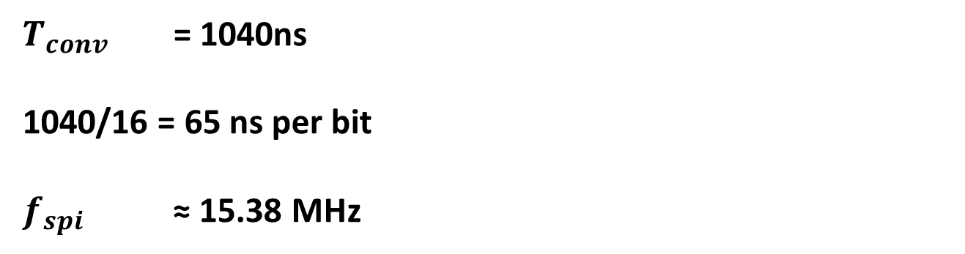
SPI Implementation with XADC Data
SPI Clock Derivation
$T_{conv}$= 1040ns
1040/16 = 65 ns per bit
$f_{spi}$ ≈ 15.38 MHz
System clock = 8 ns
Count 8 cycles → 64 ns
Occasionally insert extra cycle
Implementation of Internal XADC Based ADC and SPI Serial Transmission on Zynq-7000 FPGA
15/22

Slide 16
Master Module Operation
DRDY triggers transmission
CS becomes LOW
SCLK generated
16-bit shift transmission happens
Implementation of Internal XADC Based ADC and SPI Serial Transmission on Zynq-7000 FPGA
16/22

Slide 17
SPI Slave Behaviour
16-bit register stores XADC data
On each falling edge:
• MSB sent to MISO
• Register shifts left
• Reloads after 16 bits
Implementation of Internal XADC Based ADC and SPI Serial Transmission on Zynq-7000 FPGA
17/22

Slide 18
Integrated Logic Analyzer
ILA Debugging
10kHz → 100000ns
100000 / 8 = 12500 samples
Depth set to 32k
Observed:
• XADC output
• DRDY
• SPI Clock
• Chip select
• MISO data
Implementation of Internal XADC Based ADC and SPI Serial Transmission on Zynq-7000 FPGA
18/22

Slide 19
Results
XADC produced clean sampled waveform
SPI serialized data correctly
Timing matched theory
Debugging verified correct design
Implementation of Internal XADC Based ADC and SPI Serial Transmission on Zynq-7000 FPGA
19/22

Slide 20
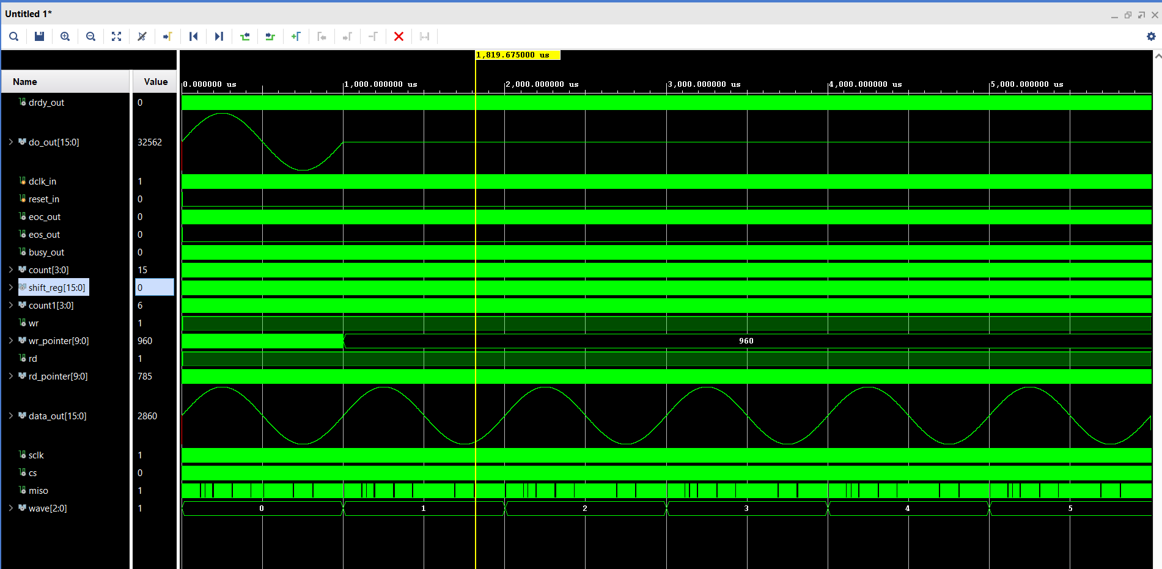
Generation Of Sine Wave Using Ram

Slide 21
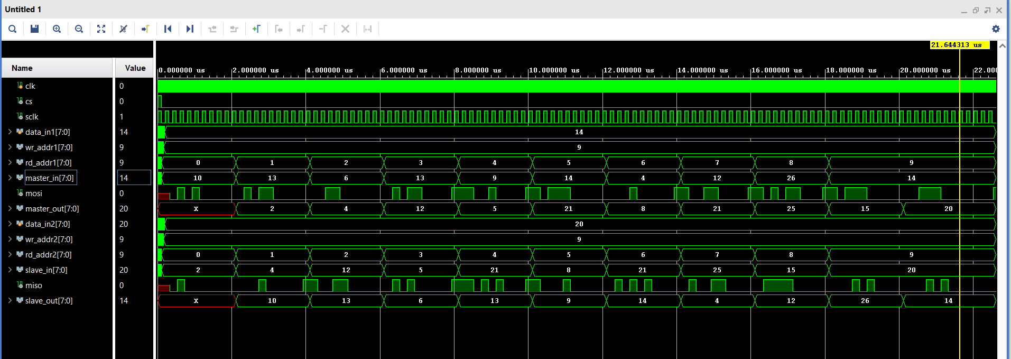
Simulation Results Of SPI Protocol

Slide 22
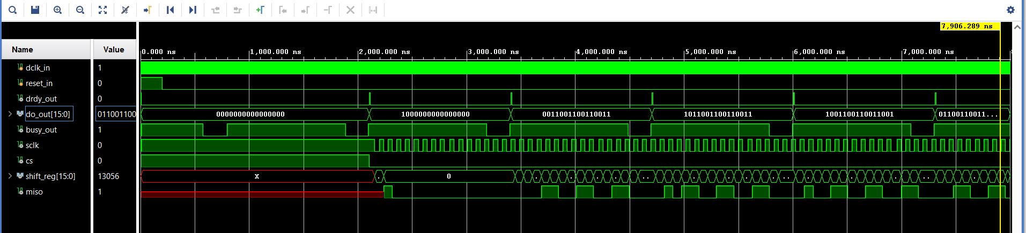
XADC Output

Slide 23
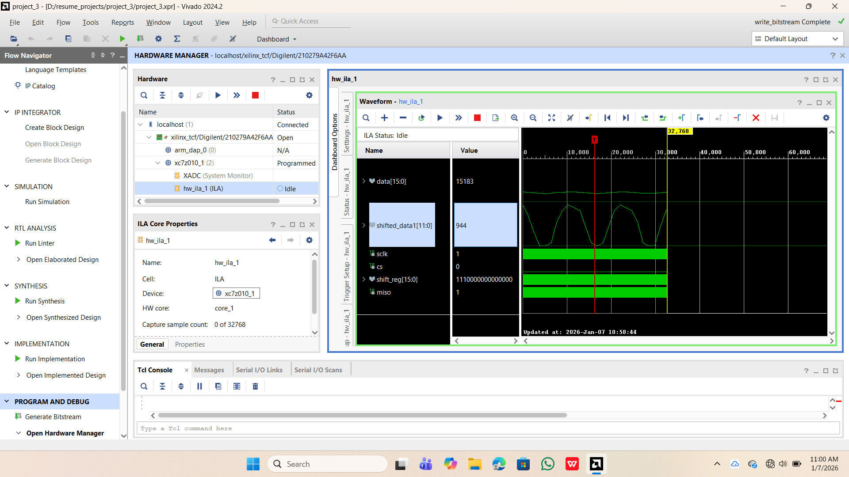
XADC Output on ILA

Slide 24
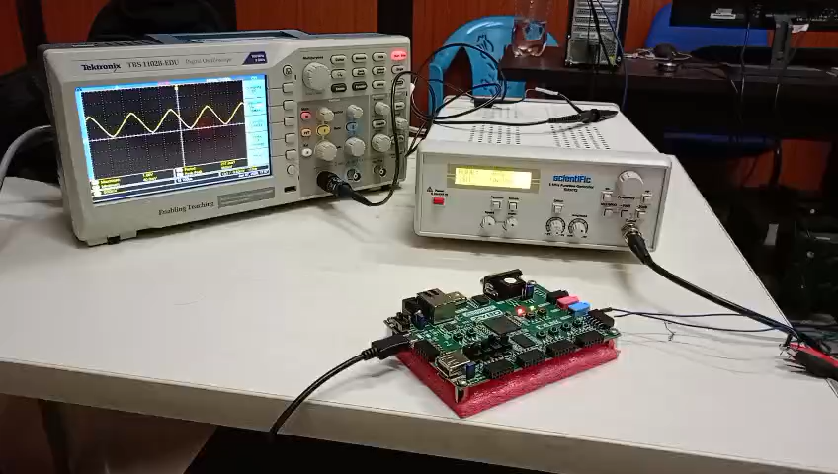
Experimental Setup and Connections

Slide 25
Interfacing PMOD AD5 with Zynq-7000 FPGA
Communication protocol: SPI
Purpose: High-resolution differential voltage measurement
FPGA controls ADC and reads digital output
Data observed using Integrated Logic Analyzer (ILA)

Slide 26
PMOD AD5 Key Features
24-bit resolution ADC
4 differential / 8 pseudo-differential inputs
SPI interface (MSB first)
On-board 2.5 V reference
50/60 Hz noise rejectionDefault gain = 128
default conversion time ≈ 100 ms

Slide 27
SPI Communication Sequence
Step 1: CS → LOW (start communication)
Step 2: Wait 100 ms (conversion & settling time)
Step 3: Send 0x58 (Read Data Register command)
Step 4: Read 24-bit ADC data via MISO
Step 5: CS → HIGH (end communication)

Slide 28
Verilog FSM Implementation
SPI controlled using Finite State Machine (FSM)
States:
S0: Idle (CS high)
S1: CS low
S2: 100 ms delay
S3: Send command (0x58)
S4: Read 24-bit ADC data
S5: CS high, restart
SCLK generated using clock divider
Shift register used for serial data reception

Slide 29
Output and Debugging
ADC data stored in 24-bit register (adc_out)
MISO, MOSI, CS, SCLK monitored using ILA
Verifies:
Correct SPI timing
Command transmission
Data reception accuracy
System ready for further processing in FPGA/PS

Slide 30
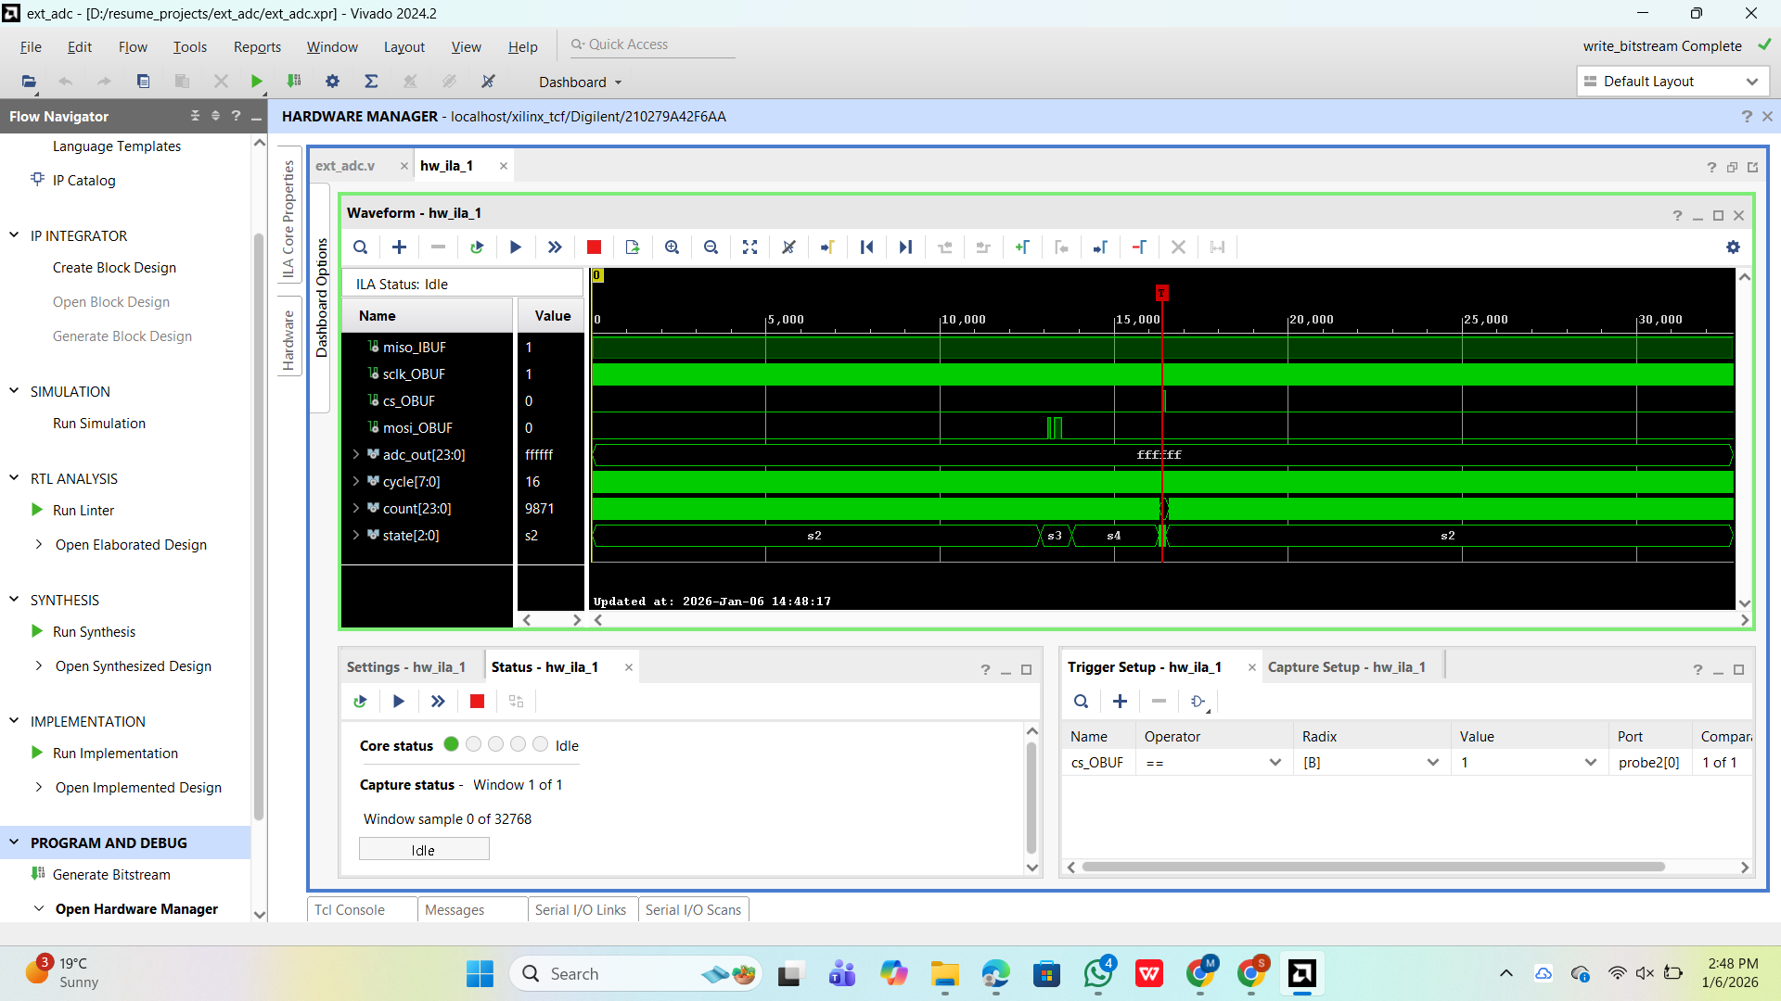
Output Waveform Observed on ILA

Slide 31
Conclusion
Internal XADC successfully replaces external ADC
Custom SPI designed and verified
Strong learning on timing and FPGA debugging
Implementation of Internal XADC Based ADC and SPI Serial Transmission on Zynq-7000 FPGA
20/22

Slide 32
Future scope
Future work
Interface with external microcontroller
Add DAC to reconstruct signal
Implement digital filters
Real-time display GUI
Implementation of Internal XADC Based ADC and SPI Serial Transmission on Zynq-7000 FPGA
21/22

Slide 33
Thank you for listening!
For more information contact :
Penmatsa Rethika Surya Sri
Menda Srihari Naidu

